Slide 1
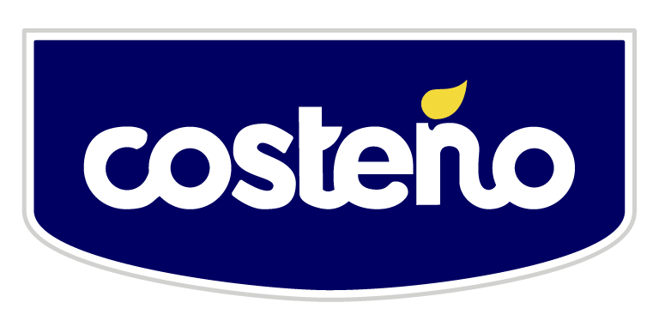
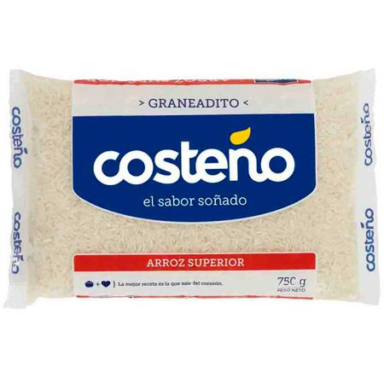
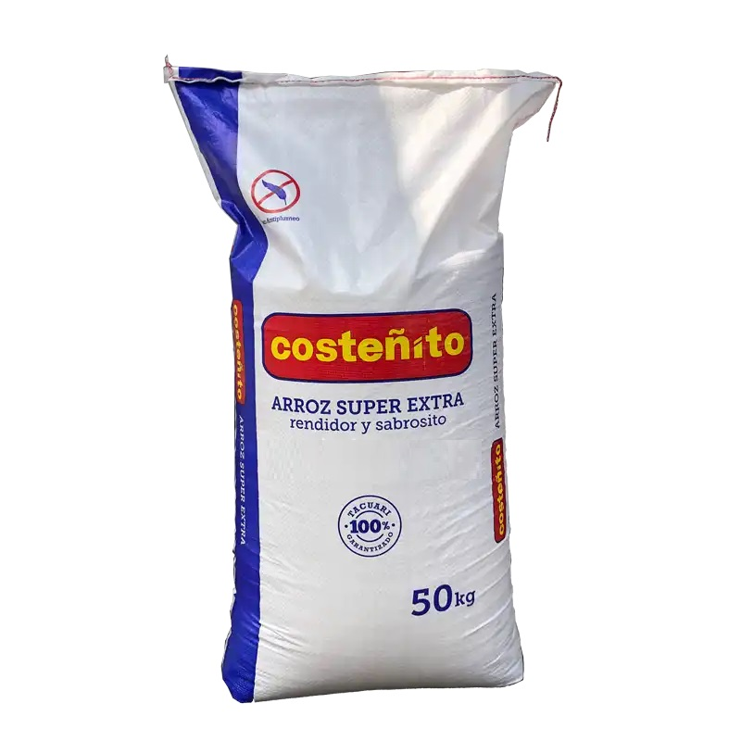
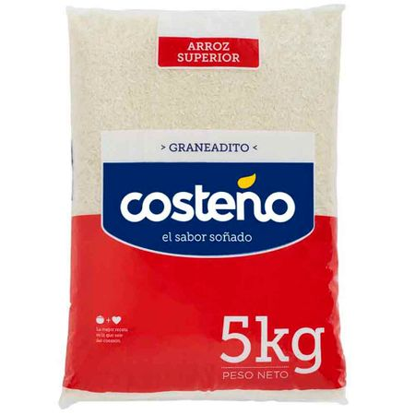
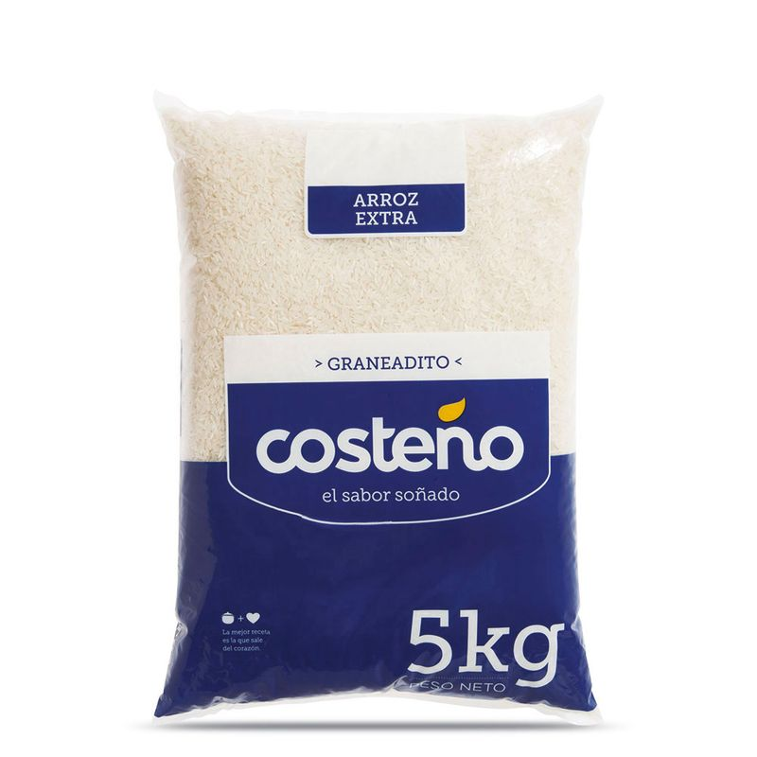
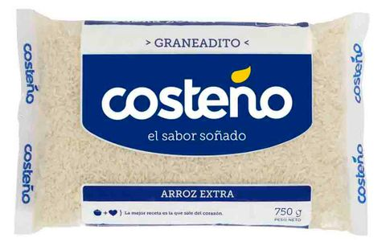
COSTEÑO ALIMENTOS
750G
5KG
50KG

Slide 2

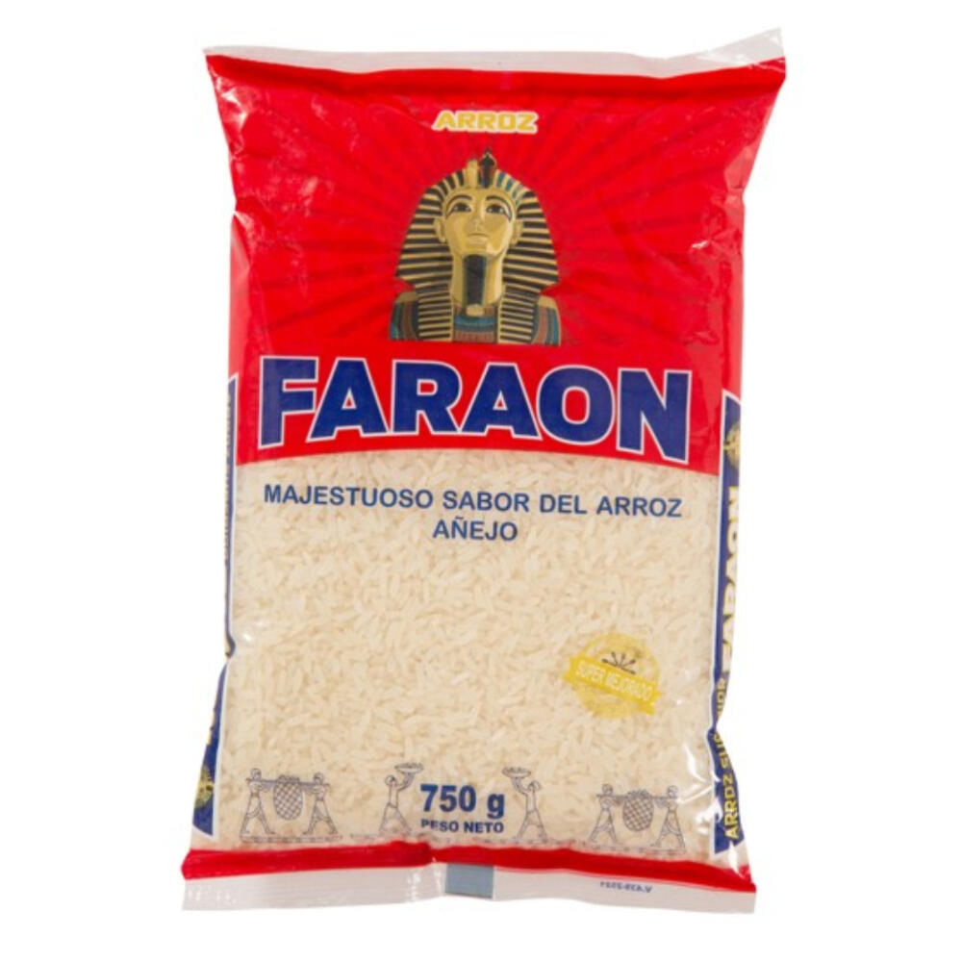
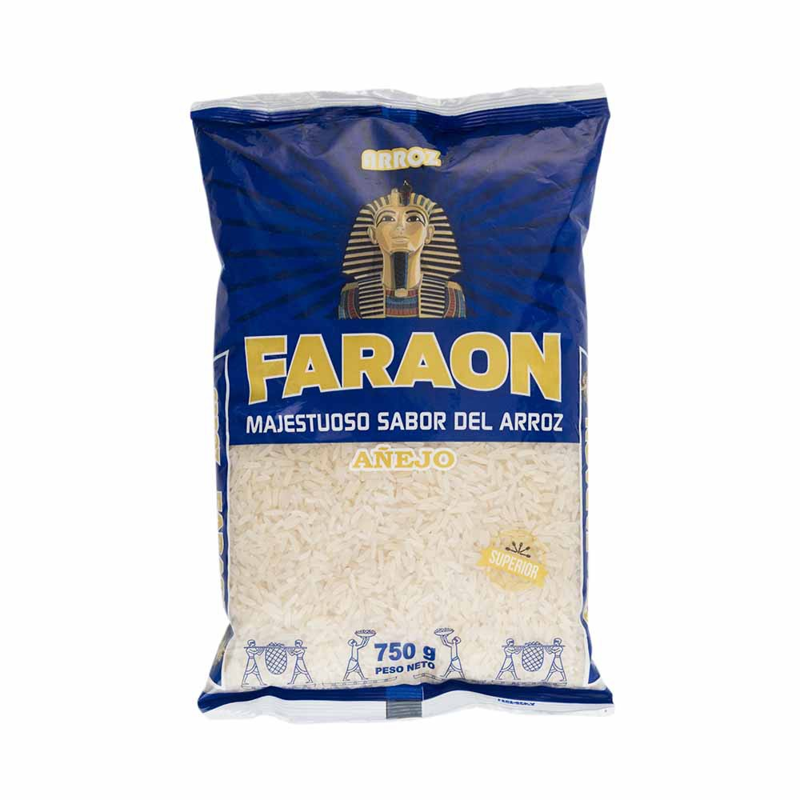
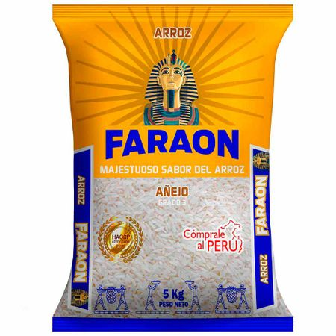
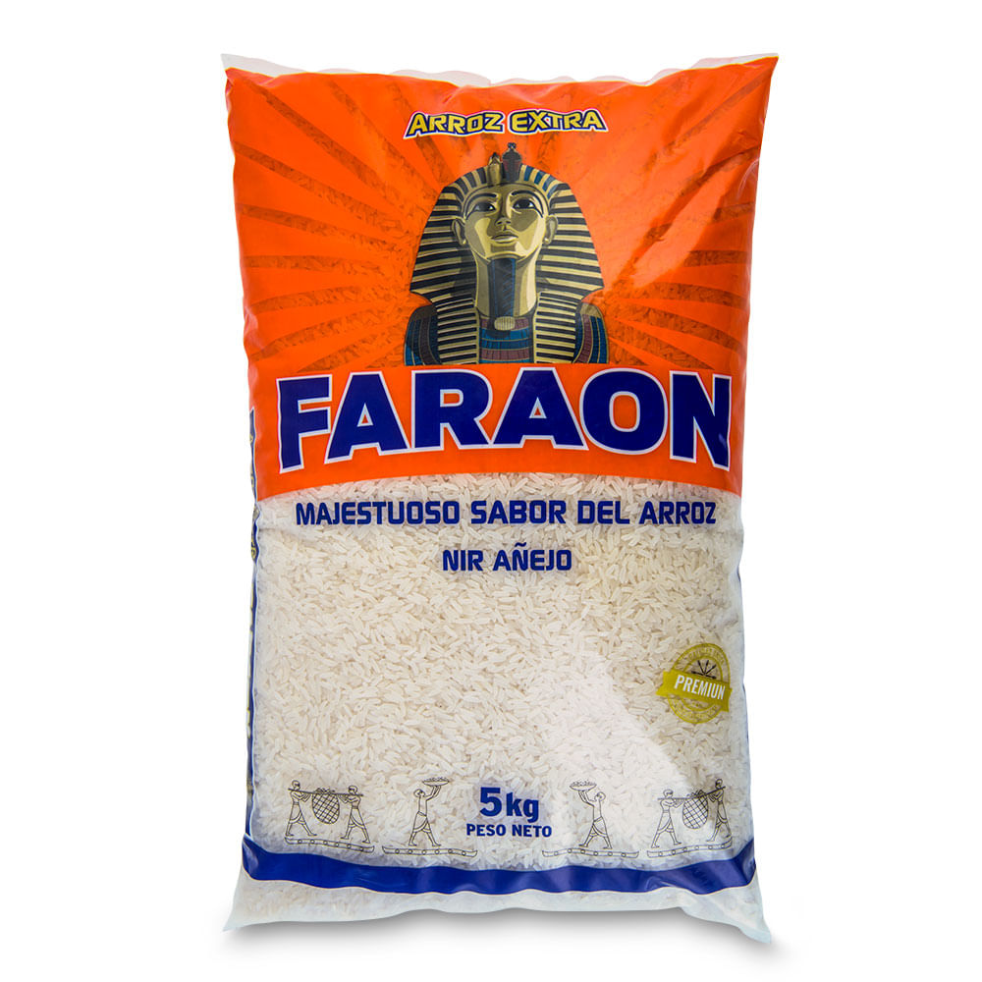
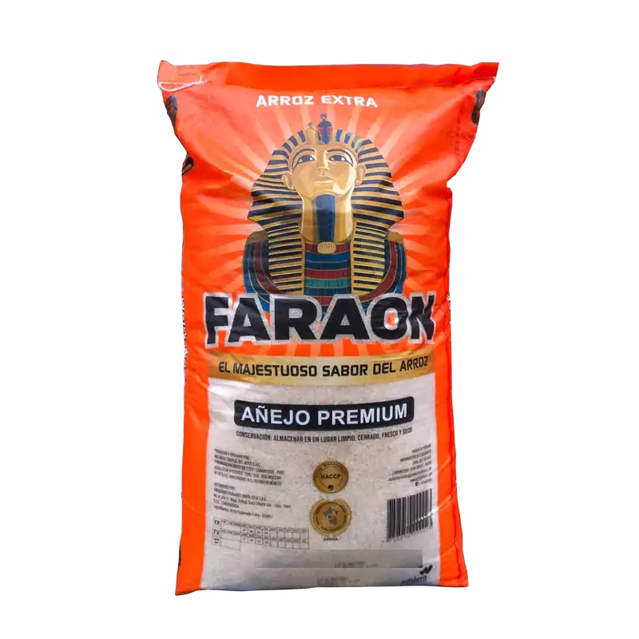
MOLINERA TROPICAL DEL NORTE
750G
5KG
50KG

Slide 3

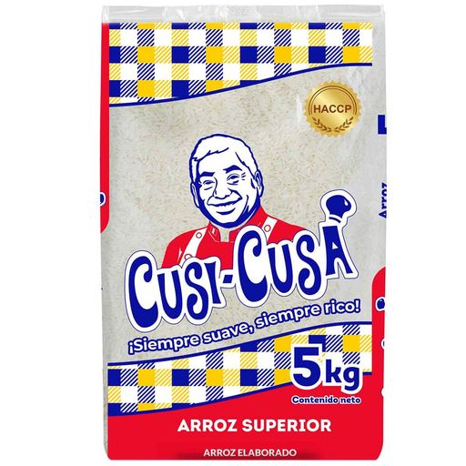
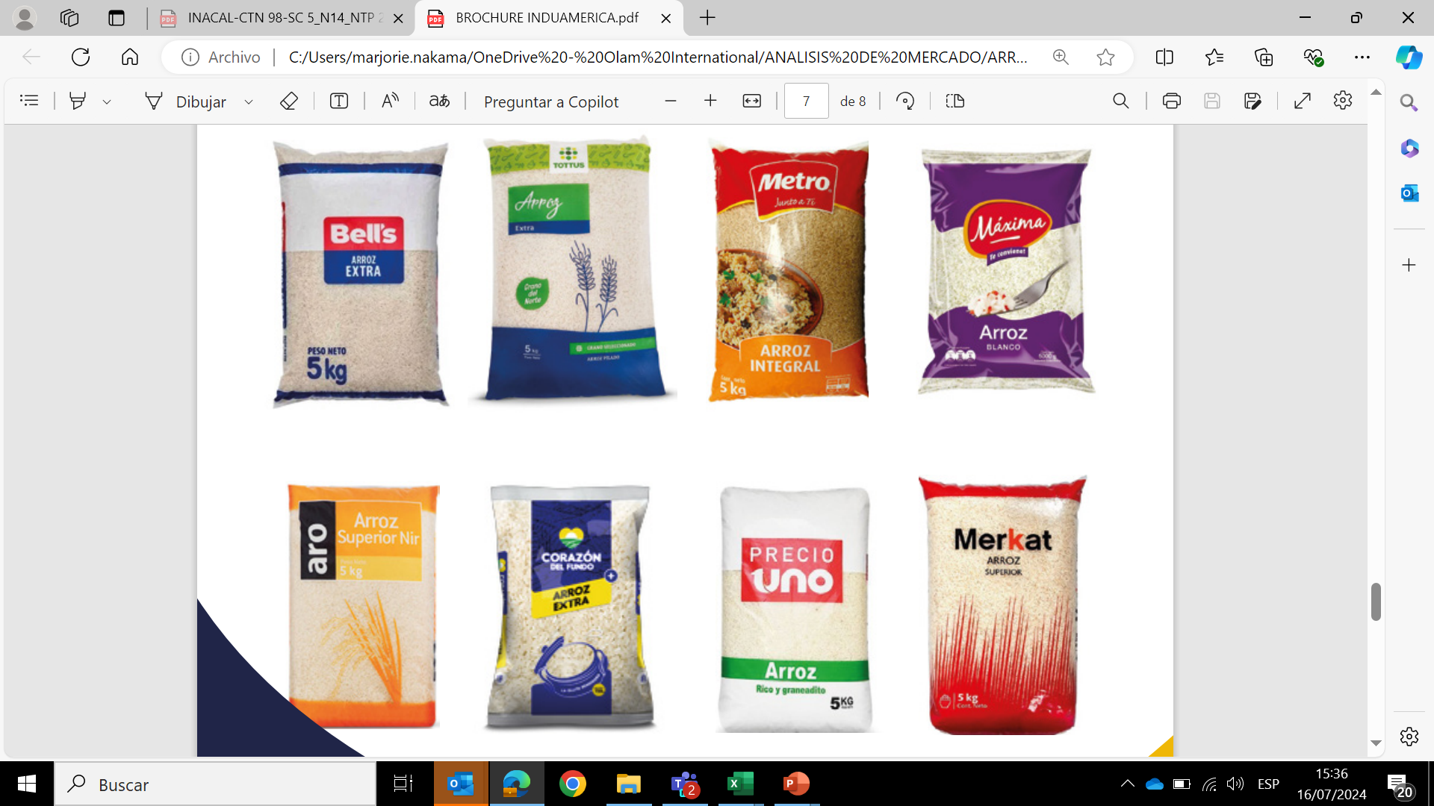
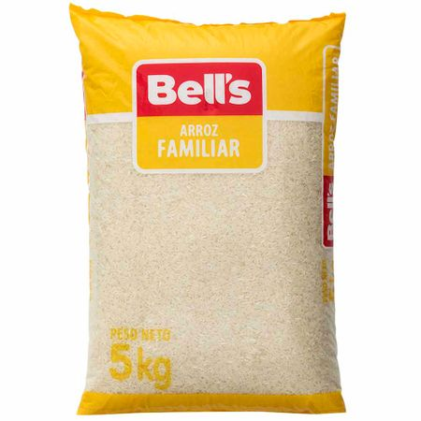
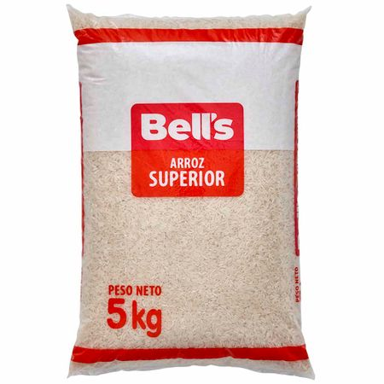
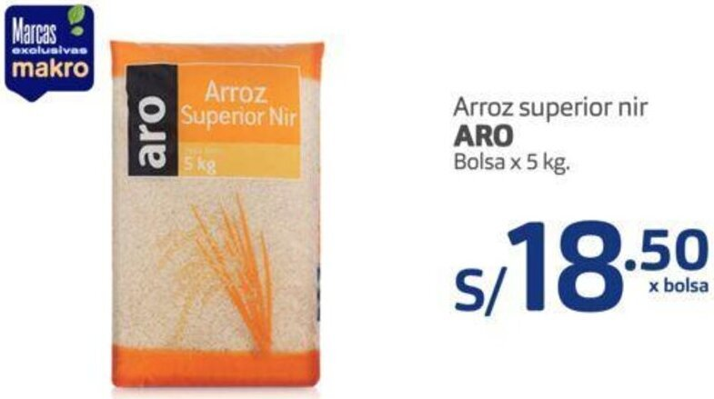
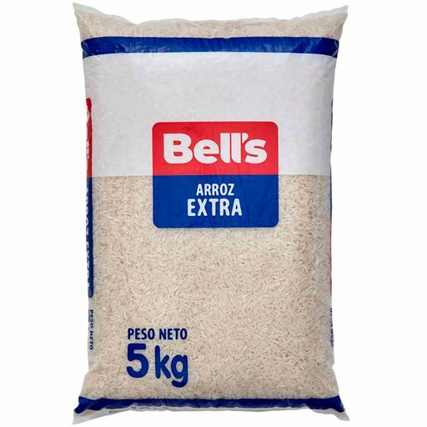
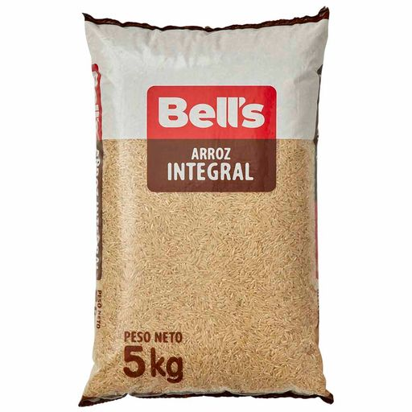
INDUAMÉRICA
5KG

Slide 4
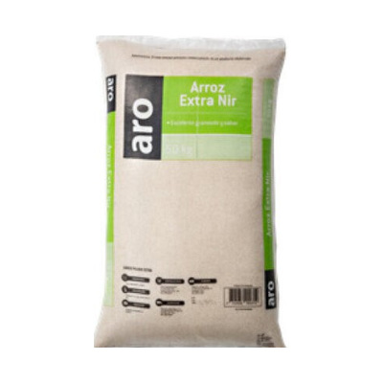
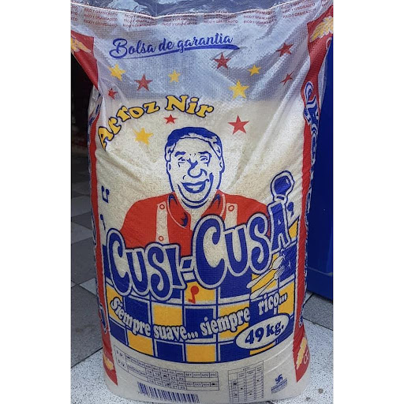
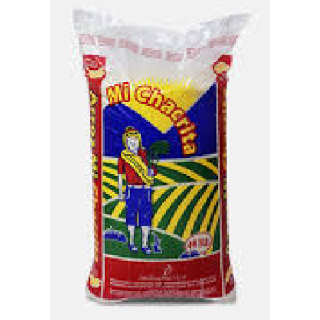
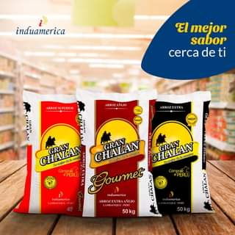
INDUAMÉRICA
50KG

Slide 5

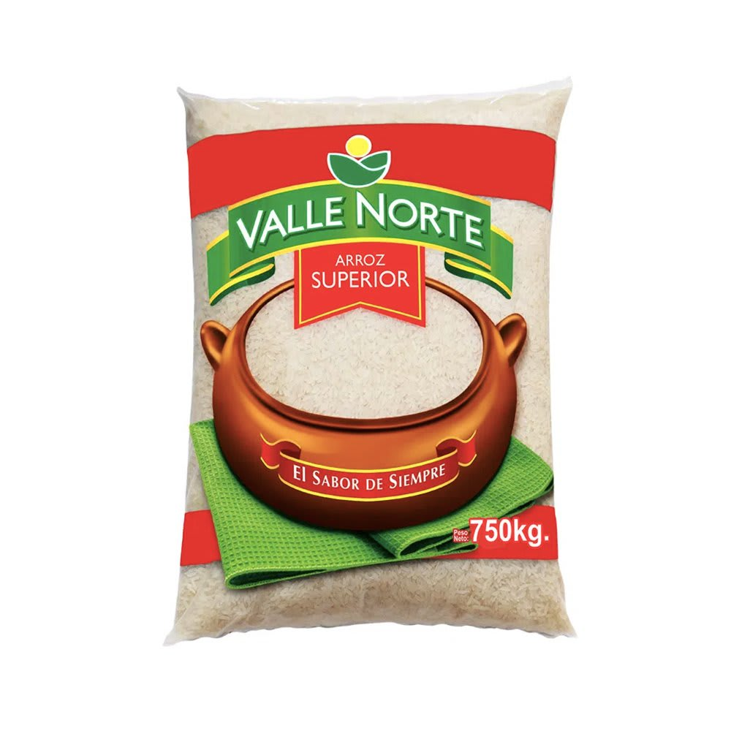
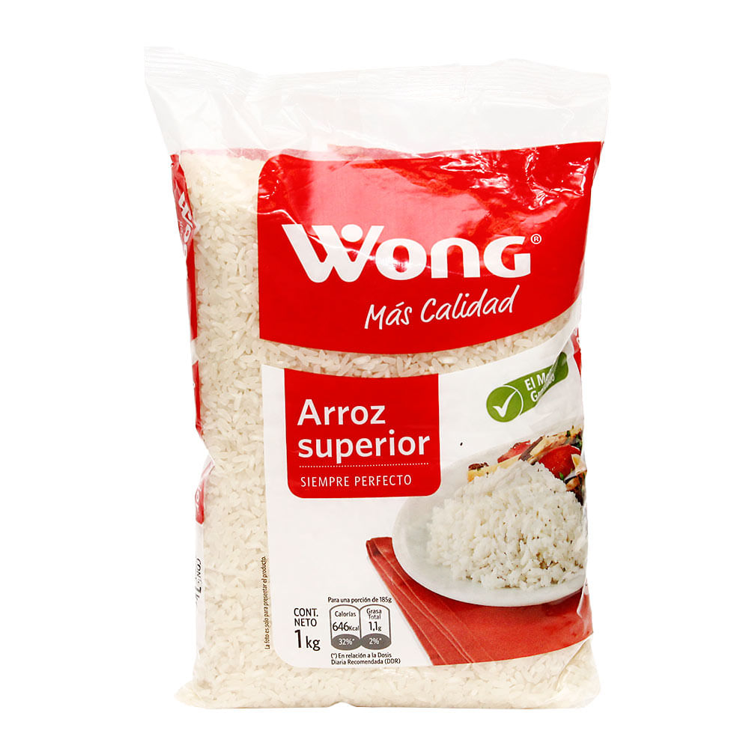
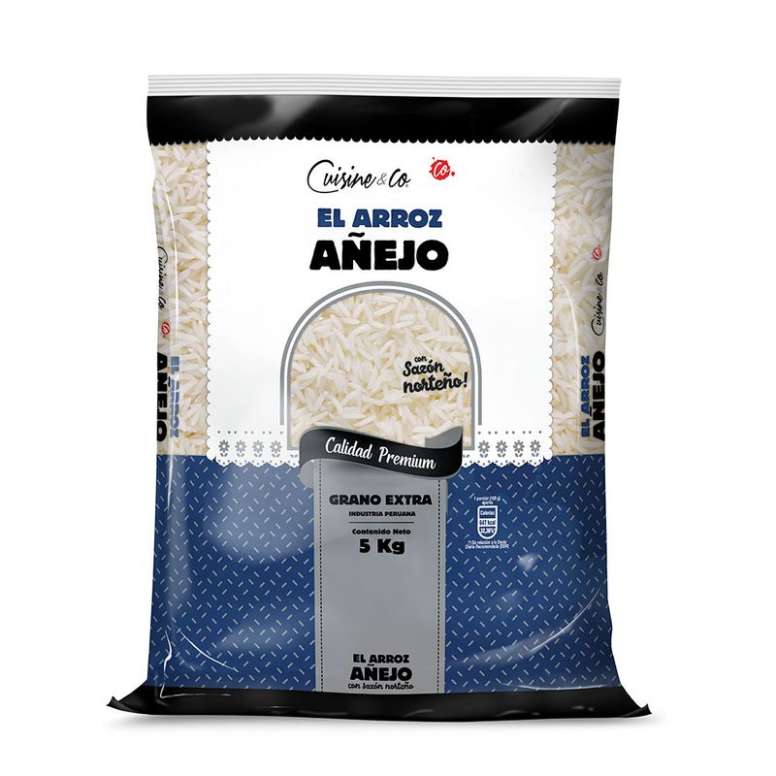
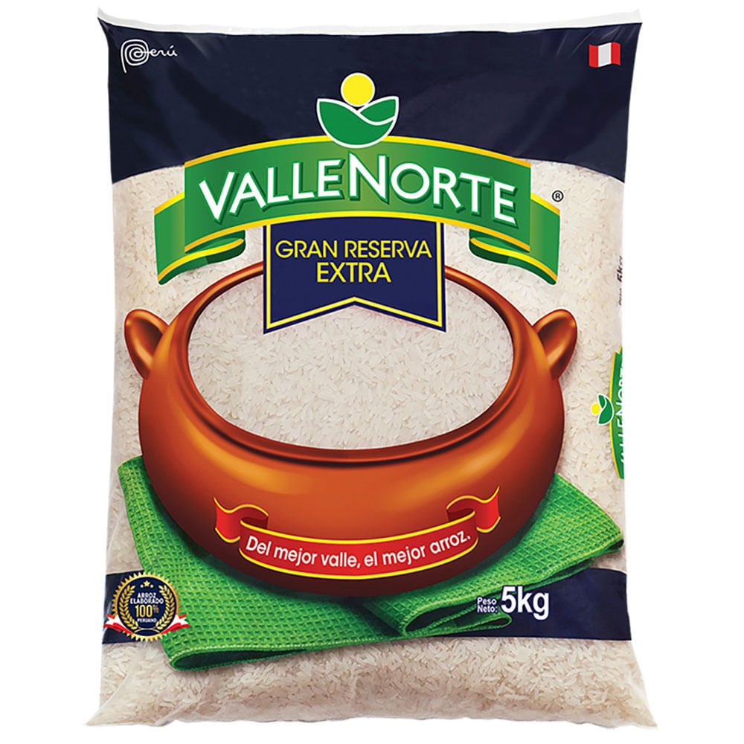
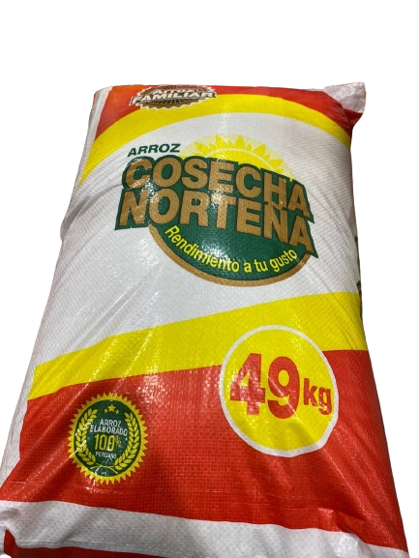
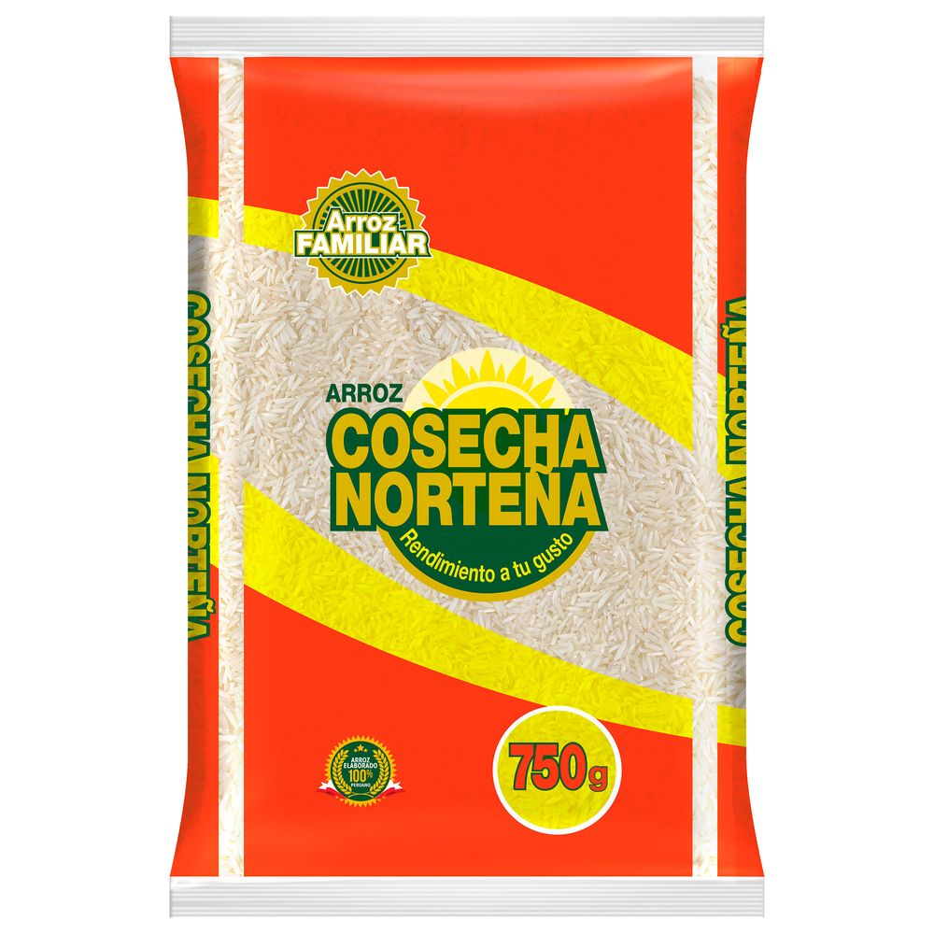
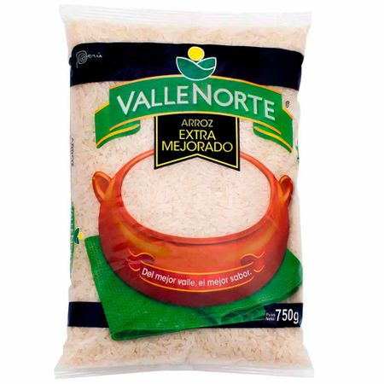
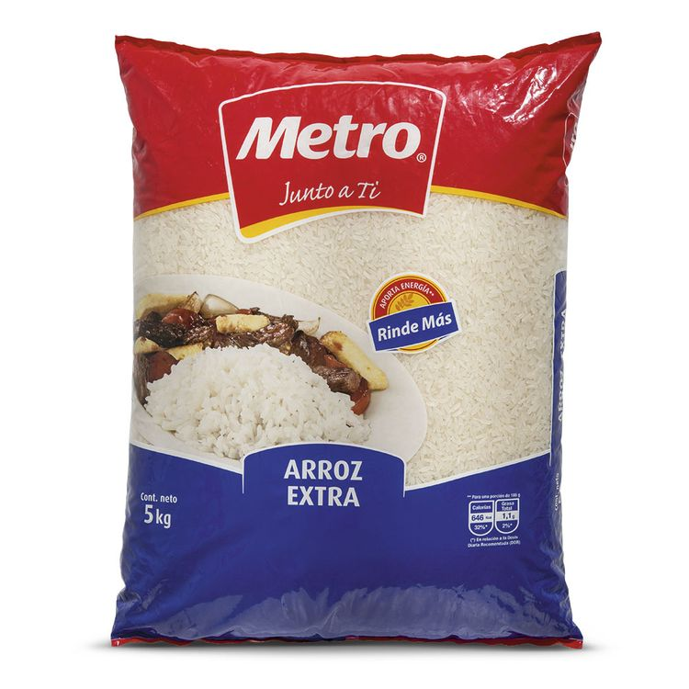
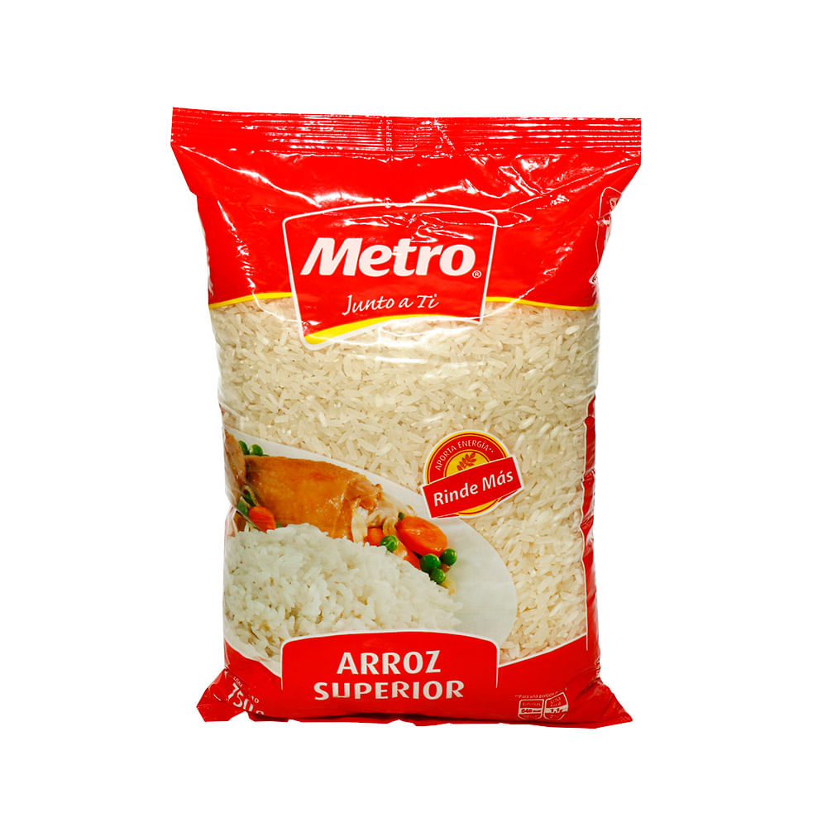
COMERCIAL MOLINERA SAN LUIS SAC
750G
5KG
49KG

Slide 6
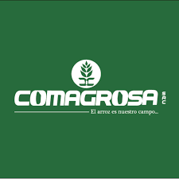
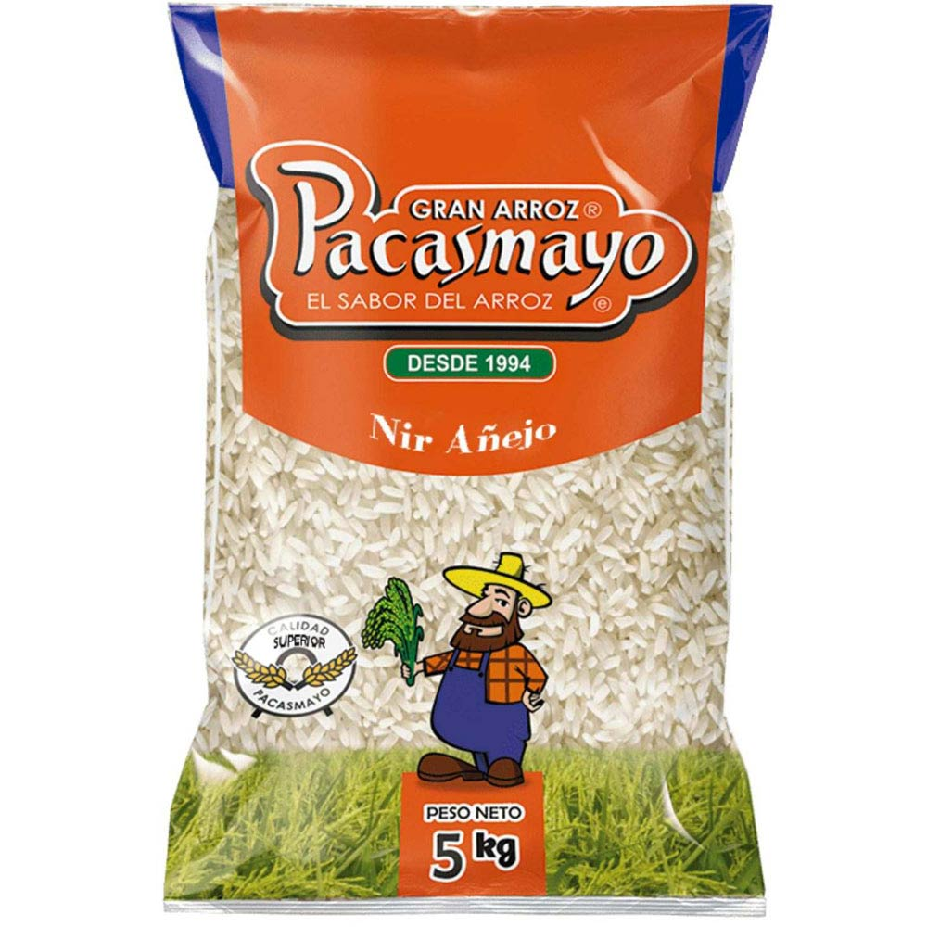
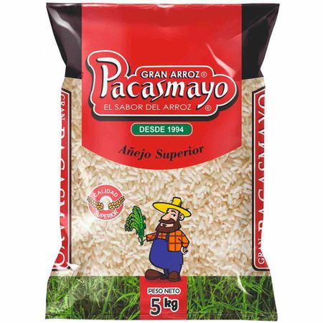
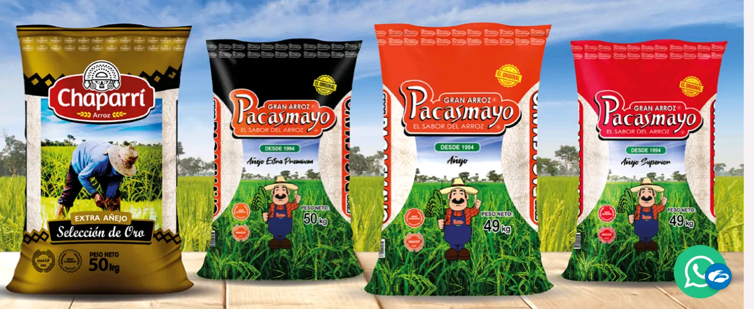
COMPAÑIA AGROINDUSTRIAL SANTA ANA
5KG
50KG

Slide 7
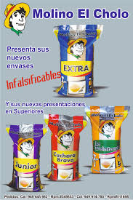
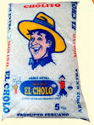
MOLINO EL CHOLO
5KG
50KG

Slide 8
MOLINO SANTA CRUZ
5KG
50KG

Slide 9
Bulk Market in General (85%)
Penetration – Bulk Market
The bulk market has a penetration of 90% of households in the country.
The market is dominated by rices without brand (35%), folowed Faraon (18%) and La Caserita (brand used by many companies) with 16%.
Rice without brand has penetration of 50%, followed by La Caserita (brand used by many companies) with 28%, Faraon is on the 3rd place with an increasing 28%, followed by Pacasmayo brand with 14%. All among 30 bulk brands in the market.
Purchasing power – Bulk Market
Brands has an average purchasing per time between 3kg-4kg.
Price – Retail Market
Average price in the market is S/3.70. Costeño is the most expensive with S/.4.20 and Faraon is 8% more expensive than average market. However, other big player in bulk market such as Pacasmayo and Saman, are among the average price. For Induamérica, is difficult to determined, as they are classified as ‘Other brands’ as any of them have enough market share to appear in the statistics.

Slide 10
Retail Market in General (15%)
Penetration – Retail Market
The retail market has a penetration of 53% of households in the country.
Costeño is the brand with highest penetration in the market with 17%, followed by Faraon with 11%.
Induamérica has several markets for supermakets and Other brands that is not accurate to determine how Much Market share they have.
Purchasing power – Retail Market
The average purchasing of a consumer is 4kg per time. However Faraon and Induamérica have the biggest purchasing power with 6Kg per time of purchasing. While Costeño has 3.8Kg per time in average.
Price – Retail Market
The average pricer per Kg is S/. 4.60. Faraon is on the average with S/. 4.70, while Costeño is above with S/. 5.00 and Induamerica with S/. 3.80 (for Private label) and S/. 4.80 (own brands).

Slide 11
DESCRIPTION – MOLINERA TROPICAL DEL NORTE BRAND: FARAON
Owner: Thomas Padilla and family.
They have 6 companies among Lambayeque, Jaen and San Martín regions in charge of manufacture, wholesale and retail rice, with a total of 73 workers.
Eastern Tropical M.
Com. FEPAZA
Strengths:
It has been growing in the national market (Moden Channel).
Segment: positioned as ‘aged rice’.
2nd private brand in the Modern Channel.
Weaknesses:
It is not very present in the traditional market of Lima.
It does not have a 2nd brand to cover other segments.
The main Industrial plant is located in a very congested and saturated area.
Opportunities:
Develop the maket in Lima for the Traditional Channel.
Brand image change is needed.
Northern Tropical M.
Com. Saint Julia
Northern Tropical M.
Com. Saint Julia
The Celestial

Slide 12
DESCRIPTION FARAON – Bulk market
Market share – Bulk Market
Total Market | 100% | 2,107,417
Market share in bulk | 85% | 1,791,305
Bulk without brand | 37% | 662,783
Faraon | 19% | 340,348
La Caserita | 16% | 286,609 | Brand used by many companies
Pacasmayo | 5% | 89,565
Costeñito | 4% | 71,652
Valle Sol | 3% | 53,739
Gallito de Oro | 2% | 35,826
Saman | 2% | 35,826
Other brands | 11% | 197,044
Faraon is the 1st brand to have the biggest market share in Peru for bulk rice.

Slide 13
DESCRIPTION FARAON – Retail market
Market share – Retail Market
 | Total Market | 100% | 2,107,417
 | Market share retail | 15% | 316,113
Company | Brands | Share per brand | MT | Share per company
Costeño | Costeño | 15% | 47,417 | 25%
Costeño | Paisana | 10% | 31,611
Faraon | Faraon | 17% | 53,739 | 17%
Induamérica | Tottus | 8% | 25,289 | 14%
Induamérica | Bells | 4% | 12,645
Induamérica | Gran Chalan | 1% | 3,161
Induamérica | Máxima | 1% | 3,161
Molino San Luis | Metro | 6% | 18,967 | 9%
Molino San Luis | Valle Norte | 3% | 9,483
Molino Chaiclayo | Danes | 2% | 6,322 | 2%
Others | Other brands | 33% | 104,317 | 33%
TOTAL |  | 100% | 316,113 | 100%
Faraon is the 2nd largest player in retail Market with only ONE brand Faraon.
750G
5KG

Slide 14
DESCRIPTION – INDUAMERICA BRAND: SEVERAL BRANDS
Owner: Perales Huancaruna family.
They have 4 companies among Lambayeque, San Martín and Lima regions in charge of collecting, manufacture and wholesaling rice, with a total of +600 workers.
Strengths:
It has been growing in the national market (Modern Channel).
It has plants in the main rice growing areas.
Weaknesses:
They are not very present in the traditional market of Lima.
It does not have a main brand that allows it to develop other market segments.
The main industrial plant is located in a very congested and saturated area.
Manufacturing private labels to supermarkets takes away its negotiating capacity.
Opportunities:
Strengthen or create a brand for the A/B segment.
Develop the Lima market in the Traditional Canal.
Brand image change is needed.
Induamérica International
Trade and Commercial
Induamerica Commercial
Induamérica International
Induamérica International
Commercial

Slide 15
DESCRIPTION FARAON – Bulk market
Market share – Bulk Market
Total Market | 100% | 2,107,417
Market share in bulk | 85% | 1,791,305
Bulk without brand | 37% | 662,783
Faraon | 19% | 340,348
La Caserita | 16% | 286,609 | Brand used by many companies
Pacasmayo | 5% | 89,565
Costeñito | 4% | 71,652
Valle Sol | 3% | 53,739
Gallito de Oro | 2% | 35,826
Saman | 2% | 35,826
Other brands | 11% | 197,044
Induamérica has diferent brands with less than 2% of market share, so they are classified as Other brands.

Slide 16
Induamérica – Retail market
Market share – Retail Market
Induamérica claim to be the leader on the retail market due to is the largest processor of private label and have several regional brands. However, we can only distinguish the bigger brands and their own brands must be classified as ‘other brands’.
 | Total Market | 100% | 2,107,417
 | Market share retail | 15% | 316,113
Company | Brands | Share per brand | MT | Share per company
Costeño | Costeño | 15% | 47,417 | 25%
Costeño | Paisana | 10% | 31,611
Faraon | Faraon | 17% | 53,739 | 17%
Induamérica | Tottus | 8% | 25,289 | 14%
Induamérica | Bells | 4% | 12,645
Induamérica | Gran Chalan | 1% | 3,161
Induamérica | Máxima | 1% | 3,161
Molino San Luis | Metro | 6% | 18,967 | 9%
Molino San Luis | Valle Norte | 3% | 9,483
Molino Chaiclayo | Danes | 2% | 6,322 | 2%
Others | Other brands | 33% | 104,317 | 33%
TOTAL |  | 100% | 316,113 | 100%

Slide 17
Retail market

Slide 18
Total Market
Bulk + Retail Market
Companies | Bulk | Retail
Molinera tropical del Norte (Faraon) | 340,348 | 53,739
Molino Santa Cruz | 89,565
Costeño | 71,652 | 79,028
Molino San Luis | 53,739 | 28,450
Molino del Norte | 35,826
Saman | 35,826
Induamérica |  | 44,256
Molino Chiclayo |  | 6,322
Others brands | 483,652 | 104,317
Bulk without brand | 680,696
Total | 1,791,305 | 316,113
Consider that must have more quantity in ‘Other brands’ that does not appear on the statistics

